Slide 1

Allan De Castro
Implémentation des Custom APIs Dataverse
Fri 16:25pm➡45’
Digital Channel : MONTMARTRE

Slide 2


Event Sponsors

Slide 3
Implémentation des Custom APIs Dataverse
Allan De Castro

Slide 4




Allan De Castro
Power Platform Technical Consultant
Avanade France
Power Platform / D365 / Azure
Linkedin.com/in/allandecastro/
Twitter.com/decastroallan
www.blog.allandecastro.com

Slide 5
Agenda
Introduction
Extend Dataverse’s messages (today)
Extend Dataverse’s messages (tomorrow)
Live Demo
Power Apps
Power Platform Extensions
Communicate with Dataverse
Event Framework
Pipeline Execution
Questions
Workflow Extensions
Low Code
Pro Code
What’s new ?
API Definition
Custom API Features
Custom API Data Model & Definition
Custom API Manager Tool
Build a Custom API

Slide 6
Introduction

Slide 7






Power Platform
The low-code platform that spans Office 365, Azure, Dynamics 365, and standalone applications
Innovation anywhere. Unlocks value everywhere
Power BI
Business analytics
Power Apps
Application development
Power Automate
Process automation
Power Virtual Agents
Intelligent virtual agents
Data connectors
Portals
AI Builder
Dataverse
Notes:
Lors de cette session nous allons nous intéresser à un élèment essentiel de la Power Platform: Dataverse qui est la base de donnée de référence pour la Power Platform qui est donc issue deu monde CRM / Xrm et qu’on ne présente plus! On va donc être vraiment au niveau le plus bas de cette platforme et on va s’intéréser à un aspect plutôt Pro Code!

Slide 8
Dataverse Extensions
When it comes to extending the functionality of Dataverse, there is a wide range of possibilities that can be divided into two categories: LowCode/ProCode.
Low Code
Pro Code
Business Rules
Calculated Field
RollUp Field
Workflows
Cloud Flows
Canvas App (mobile & embedded)
…
WebResources
JavaScript
PCF
Plug-ins
Custom Actions
Cloud Flows
Azure
Notes:
Quand on souhaite étendre Dataverse on a plein de chose à disposition qu’on peut segmenter un peu en deux catégories: Low Code & Pro Code

Slide 9



Communicate with Dataverse
How to communicate externally and internally with Dataverse? What about the SDK?
Web Services
SDK
.Net Framework
Web API EndPoint
Organization Service (SOAP EndPoint)
Plug-ins / Workflow Extensions
Dataverse
SDK Client (SOAP)
.Net Core
Create
Update
Retrieve
RetrieveMultiple
SDK Client
Announcing the .net Core SDK for Common Data Service (CDS) - External Client Development
Notes:
On va rentrer dans le vif du sujet et essayer de résumer les principes de communication avec Dataverse. Pour communiquer on va utilizer des web services qui sont aux nombre de deux pour Dataverse..
Web API : Endpoint HTTP Rest Odata Organization Service :
The organization service is optimized for use with the .NET Framework and the SDK assemblies in the Microsoft.CrmSdk.CoreAssemblies NuGet package provide the classes for the IOrganizationService interface necessary work with data and metadata using this service.
Some extension capabilities, such as plug-ins and workflow extensions, depend on the .NET Framework and classes defined in these assemblies so the organization service is the only option when using these methods to extend Dataverse.
Platforme implémente de l’évenementill avec des messages avec lesquelels on va pouvoir intérargir :. These messages correspond to the events that are emitted by the event framework. More information: Event Framework → Posibilité d’ajouter des messages custom mais aussi de les étendre c’est à dire Account Creation = Plugins
“we will update the .NET SDK assemblies so that they will continue to work after the SOAP endpoint is removed”
The SOAP endpoint for the organization service was introduced in 2011 and we have announced that it is deprecated.
This means that it will continue to work and be supported until we remove it. We have also announced that we will update the .NET SDK assemblies so that they will continue to work after the SOAP endpoint is removed.
This means that there will be updated SDK assemblies available before the SOAP endpoint is removed and developers will be required to update their code to use these new assemblies at some point in the future.
https://docs.microsoft.com/en-us/powerapps/developer/data-platform/org-service/overview

Slide 10
Event Framework
Dataverse detects when events occur on the server
Event Framework
Message Operation:
Create, Retrieve, RetrieveMultiple, Update, Delete, Associate and Disassociate
Ability to create custom messages (or to use messages specific to the application deployed, e.g WinOpportunity for D365 Sales).
IncrementByTen
Plugin: An extension based on a specific Message
e.g: Creation of an Account

Slide 11
Event Framework Pipeline Execution
Web services (Web API & SOAP)
Message based data operations
Each message has:
Name
Input parameters
Output parameters
OrganizationRequest derived classes:
NameRequest
NameResponse
Step = Plug-in type + stage
Execution order (rank) defines order of steps in stage
OrganizationRequest
Parameters
Name
PreValidation stage handlers
Transaction start
PreOperation stage handlers
MainOperation stage (internal)
PostOperation stage handlers
Transaction End
OrganizationResponse
Results
Name
Asynchronous handlers
Notes:
OrganizationRequest request = new OrganizationRequest() {
RequestName = "Create",
Parameters = parameters };
OrganizationResponse response = svc.Execute(request);
var id = (Guid)response.Results["id"];

Slide 12




Questions
TIME & COST
How to reuse pieces of code for an entire project?
SECURITY
How to call code that uses external services securely from a JavaScript (Ribbon button)?
EXTEND
How to call the same logic in different ways? (Integration scenario, missing functionalities…)?
TEAM
How to provide complex logic that can be consumed by makers/customizer?

Slide 13
Extend Dataverse’s messages (today)

Slide 14
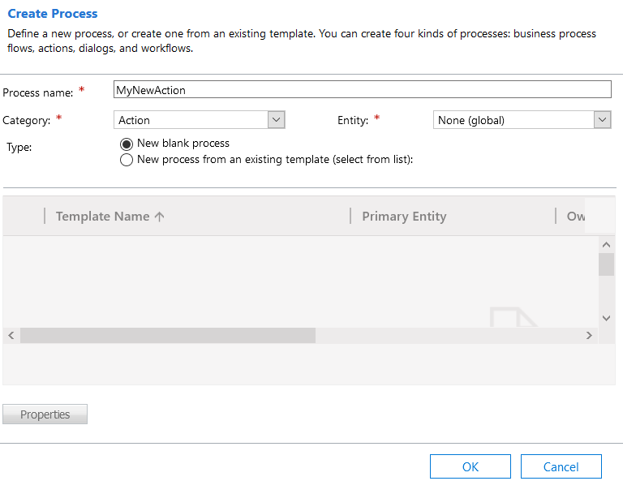
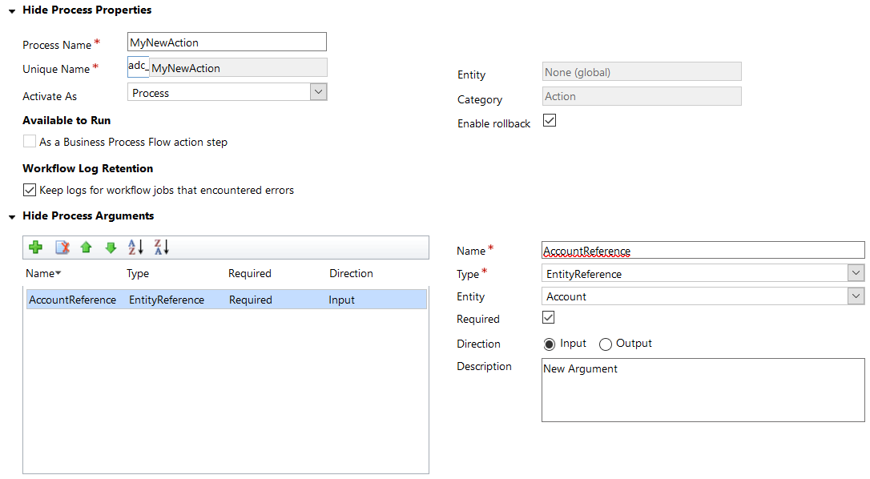
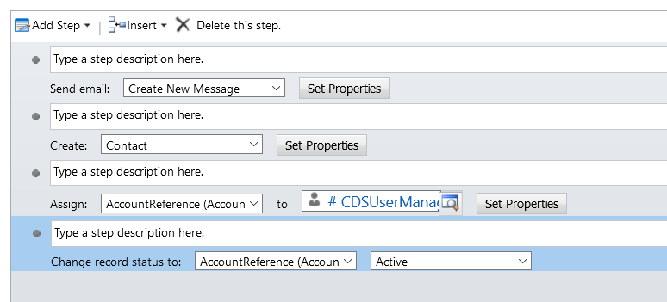
Workflow: Custom Action using Low Code
Notes:
Create custom messages to extend Dataverse
Combine multiple message requests into a single request
Generate a workflows registered in the stage MainOperation (30) of the execution pipeline.
Entity or Global binding
Plug-ins can be registered on this message
Message Available through Dataverse Web Services
Always execute in organization scope
Runs under the security context of the calling user

Slide 15
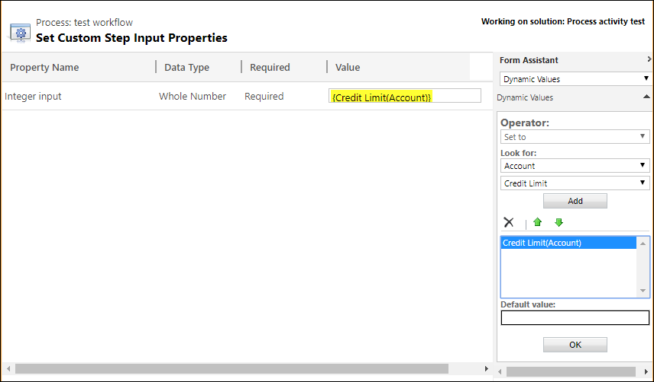
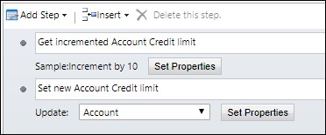
Workflow: Custom Action using Pro Code
Re-usable component for configurable business logic
Extend the actions and conditions available for Workflow designer
In a standard workflow we want to have the possibility to increment a value by 10 (potentially make rounding, following a particular rule):
Accept a decimal input parameter
Output a value equal to the input parameter plus 10.
using Microsoft.Xrm.Sdk.Workflow;
using System.Activities;
namespace SampleWorkflowActivity
{
public class IncrementByTen : CodeActivity
{
[RequiredArgument]
[Input("Decimal input")]
public InArgument<decimal> DecInput { get; set; }
[Output("Decimal output")]
public OutArgument<decimal> DecOutput { get; set; }
protected override void Execute(CodeActivityContext context)
{
decimal input = DecInput.Get(context);
DecOutput.Set(context, input + 10);
}
}
}
Source: aka.ms/CDS-Workflow-Extensions
Notes:
You can use the Perform Action activity to execute any custom actions or the following system messages called Command Actions:

Slide 16
Latest News
Microsoft’s desire to make Custom Actions and Workflows obsolete.
Workflows
Custom Actions
📅 October 26, 2020: Introducing Custom API preview
How to secure an HTTP call on the client side?
No integration scenario possible Reusable Logic available within Power Automate / Workflows
Power Automate Synchronous ? Plug-in!
Notes:
Get Variable ? Get User TimeZone Create a team..

Slide 17
Extend Dataverse’s messages (tomorrow)

Slide 18



APIs
API: Solution that allows applications to communicate with each other and exchange services or data with each other.

Slide 19
Custom APIs Features
Custom API, Request Parameters and Response Property Included in Solutions!
Solution
Aware
Allowed Custom Processing Step Type
Possibility to restrict or not other plugins to be registered on this new message.
Limit the execution according to a Dataverse security privilege
Execute Privilege Name
Is Function
Ability to specify whether it is a Function or an Action (as described in OData standard)
Defines whether this message will be exposed through Web Services
Is Private
Implement IPlugin Interface (MainOperation Stage)
Same development as plug-ins
StringArray (new), Guid (new), EntityCollection (new) and Entity (new)
New Input & Output Parameters (EntityCollection, StringArray..)
Reusable
Call from Power Automate, Plug-ins, Frontend (JS & PCF)
Notes:
StringArray (new), Guid (new), EntityCollection (new)

Slide 20
Custom APIs vs Custom Action
Capability | Workflow Custom Action | Custom API
Declarative logic with workflow | Yes | No
Require specific privilege | No | Yes
Block Extension by other plug-ins | No | Yes
Make message private | No | Yes
Create OData Function | No | Yes
Bind an operation to an entity collection | No | Yes
📢 Full List: Compare Workflow Custom Action and Custom API

Slide 21
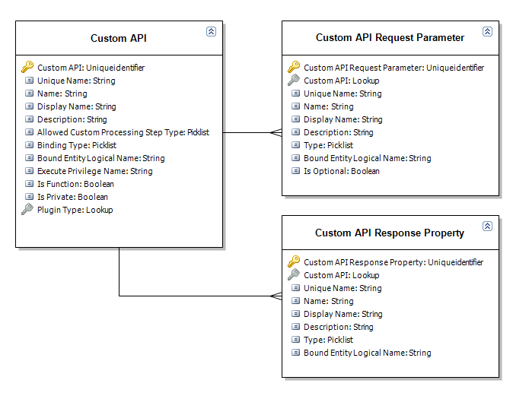
Custom APIs

Slide 22
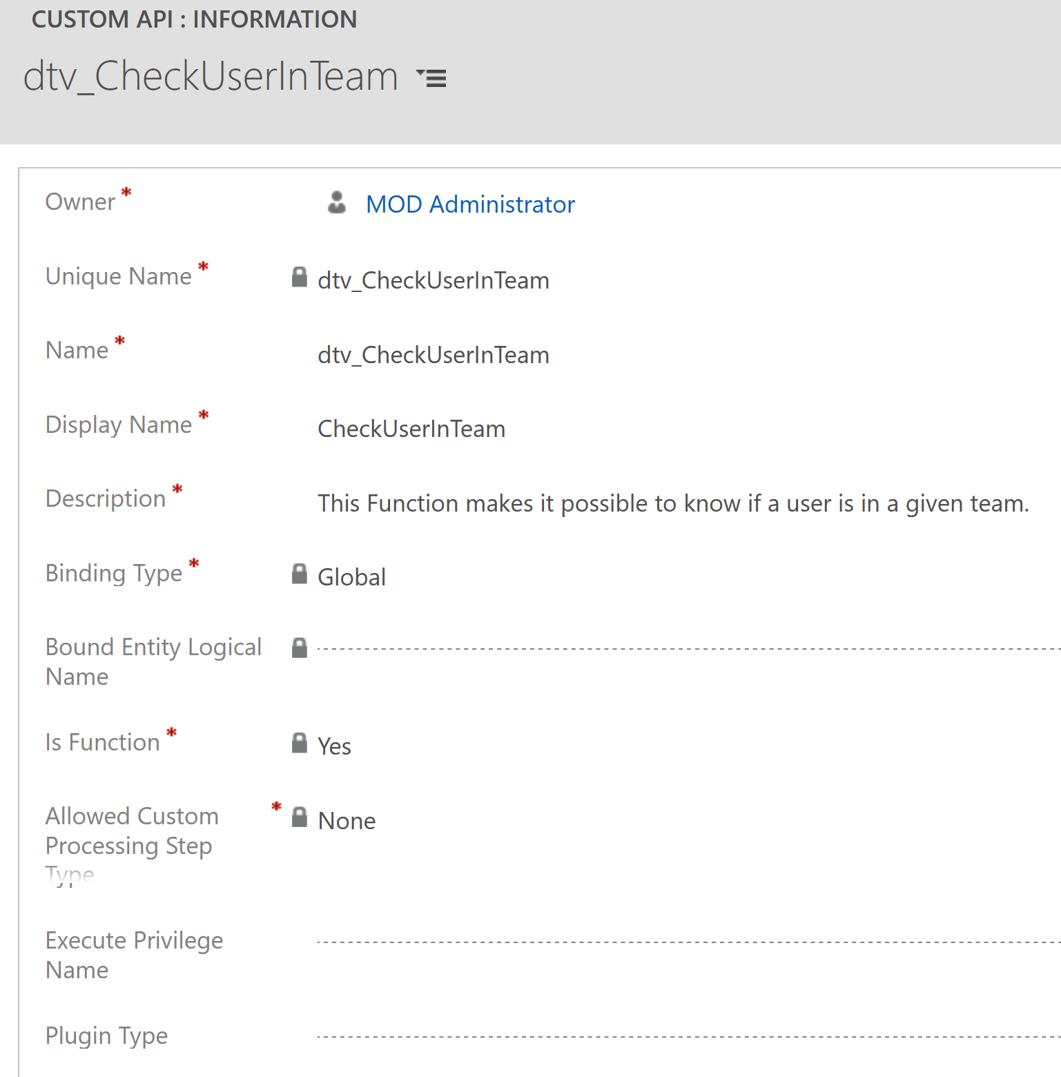
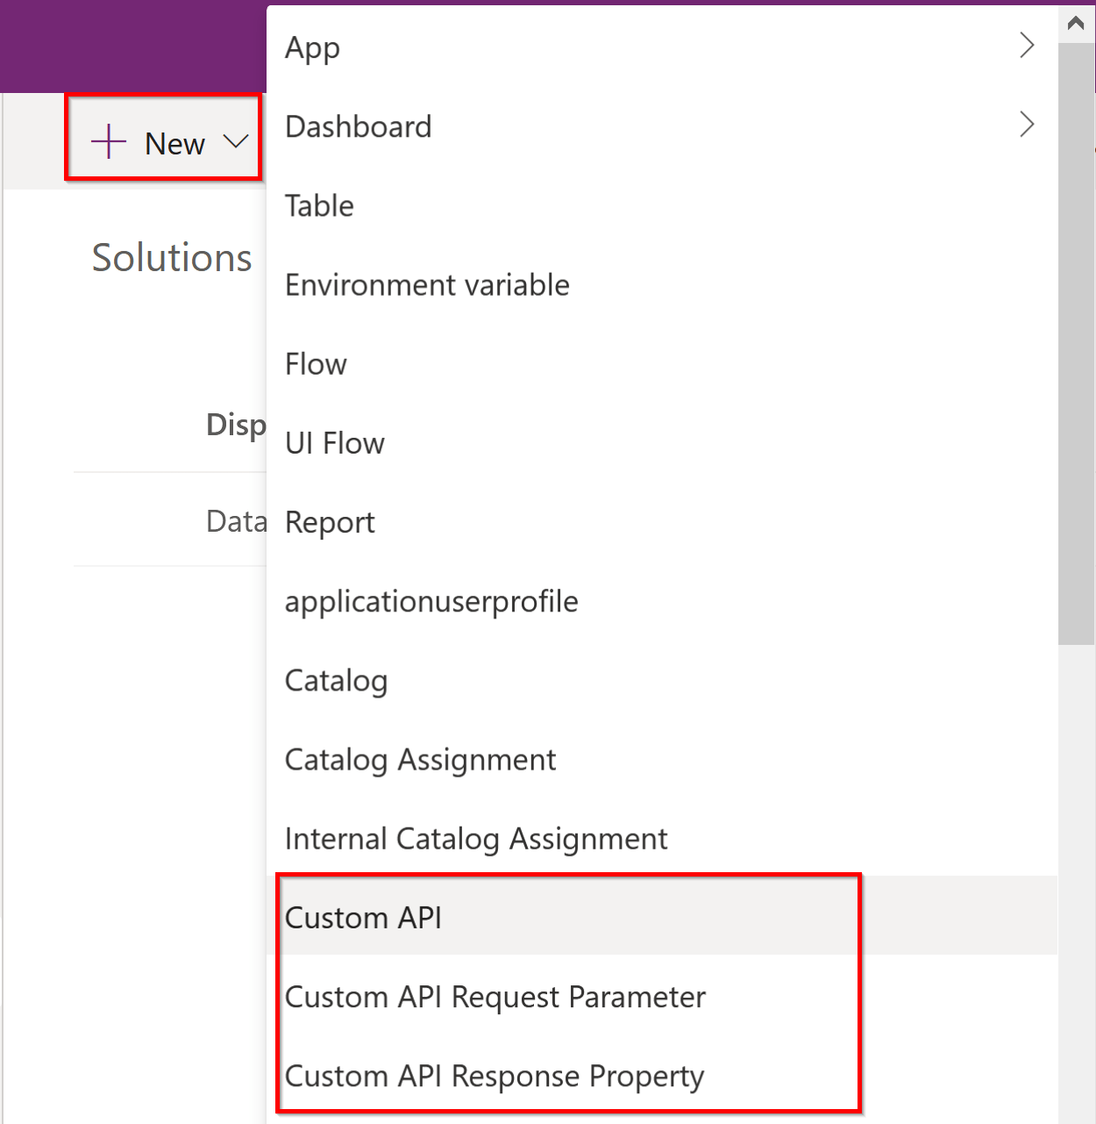
Custom API Definition

Slide 23
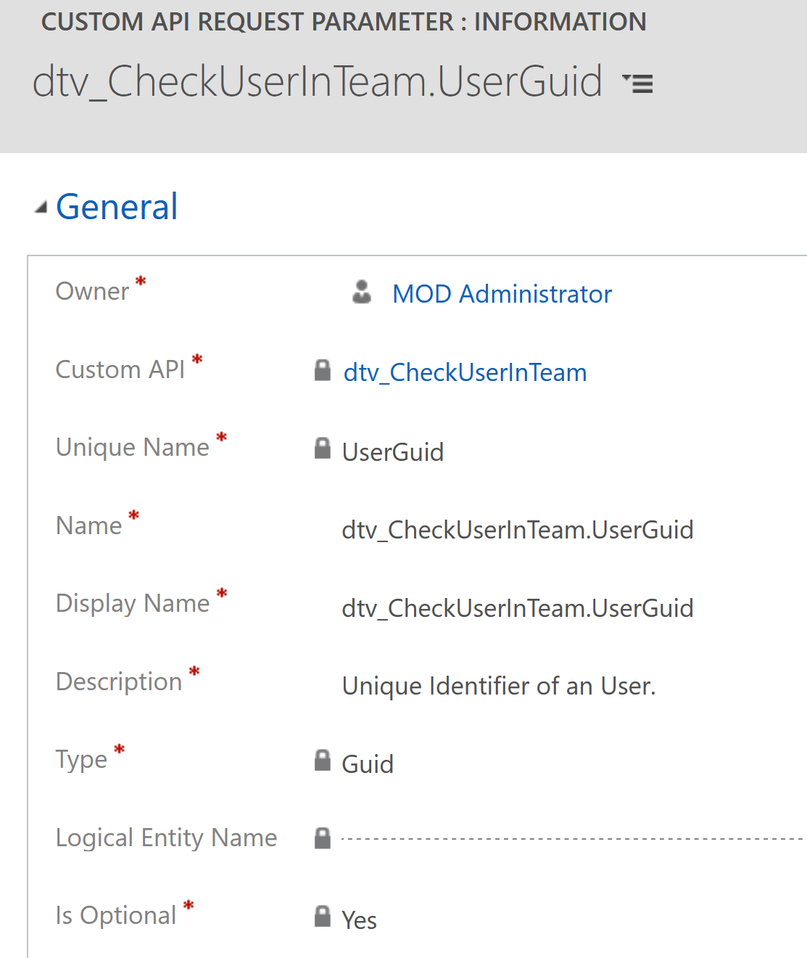
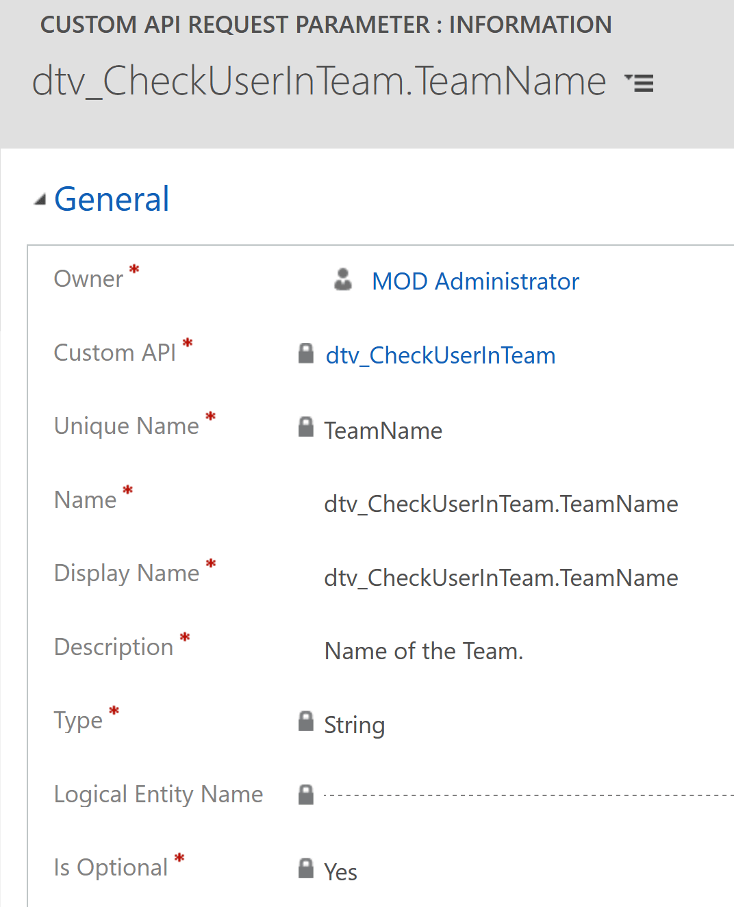
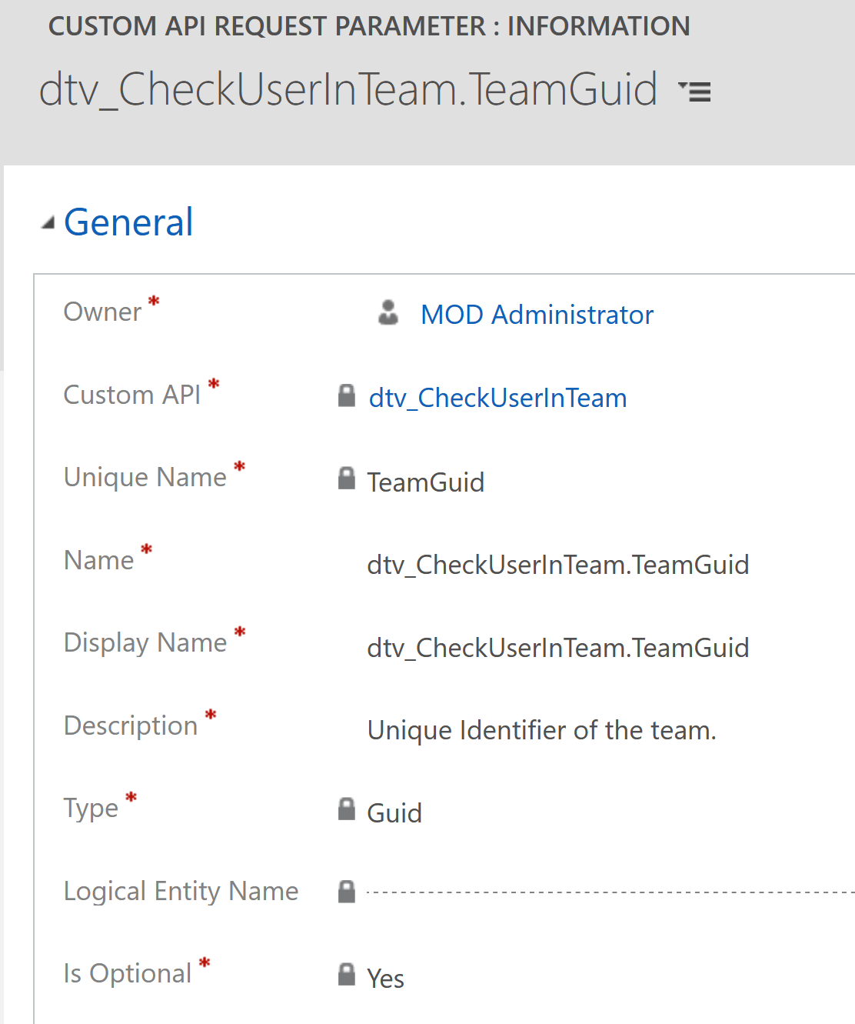
Custom API Request Parameter

Slide 24
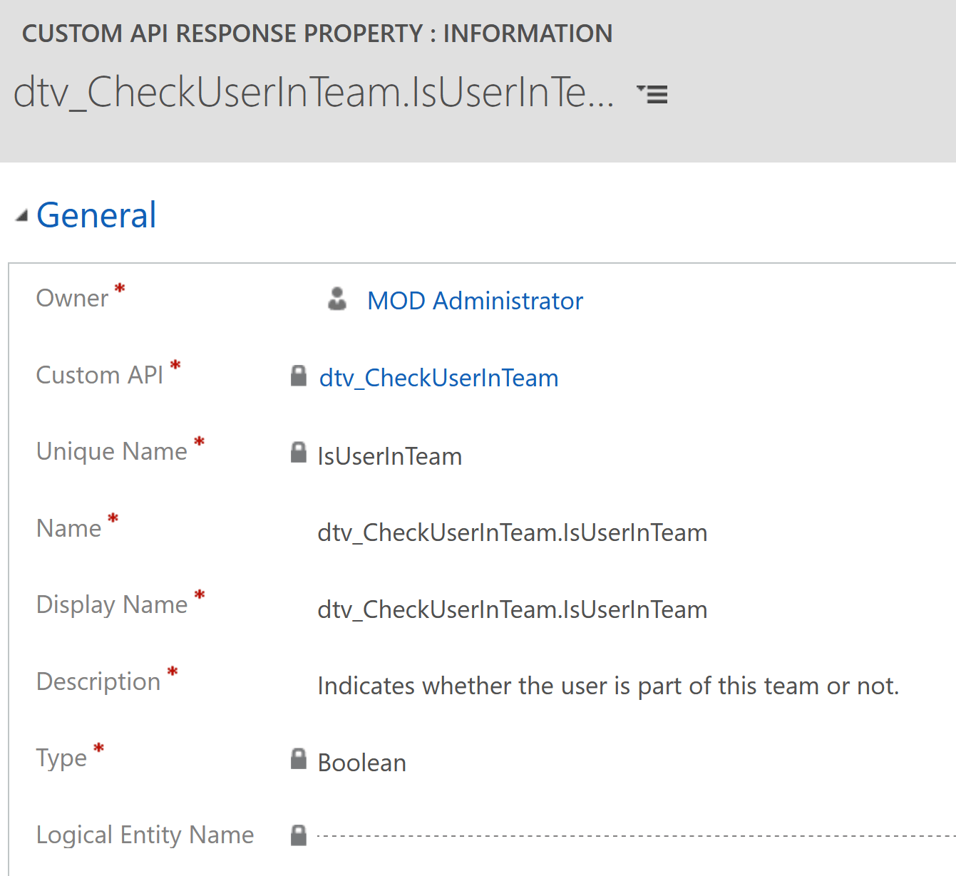
Custom API Response Property
Notes:
Réponse obligatoire pour un GET!

Slide 25


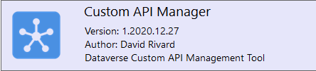
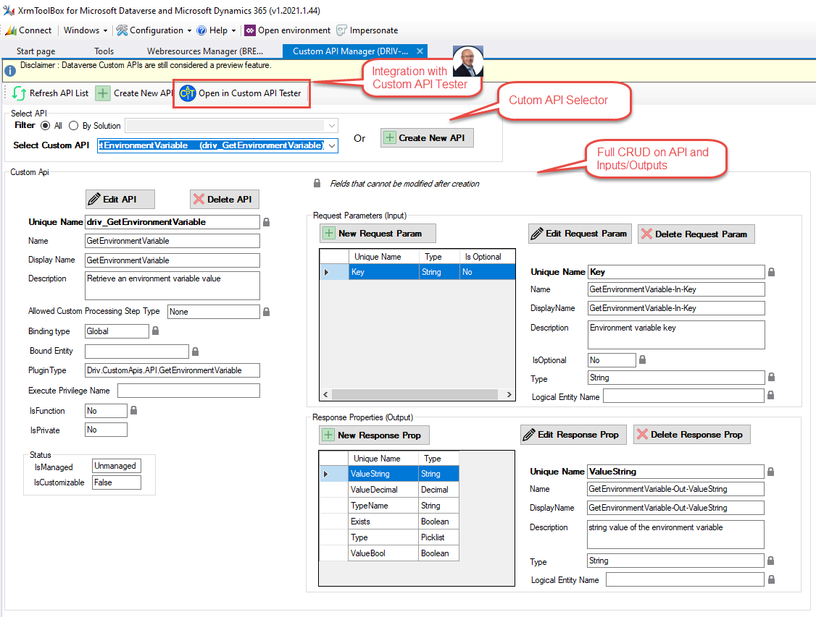
Custom API Manager for XrmToolBox
360° View of custom APIs in environment
Full CRUD operations on Custom API
Integrated with Custom API Tester

Slide 26
Live Demonstration

Slide 27
Use Cases
Create a Solution
Create an Environment Variable
Create a Custom API « GetEnvironmentVariable »
Execute and Test Custom API
Custom API Tester
Power Automate
Optional: Hacking the Custom API

Slide 28
Link(s)
Microsoft:
Create and use Custom APIs
Allan De Castro:
Implementing Dataverse Custom APIs (a.k.a new Custom Actions)
David Rivard:
Dataverse Custom API: Keep It Private
Custom API Manager for XrmToolBox
Dataverse Custom API: AllowCustomProcessing Explained

Slide 29
Any Questions?

Slide 30
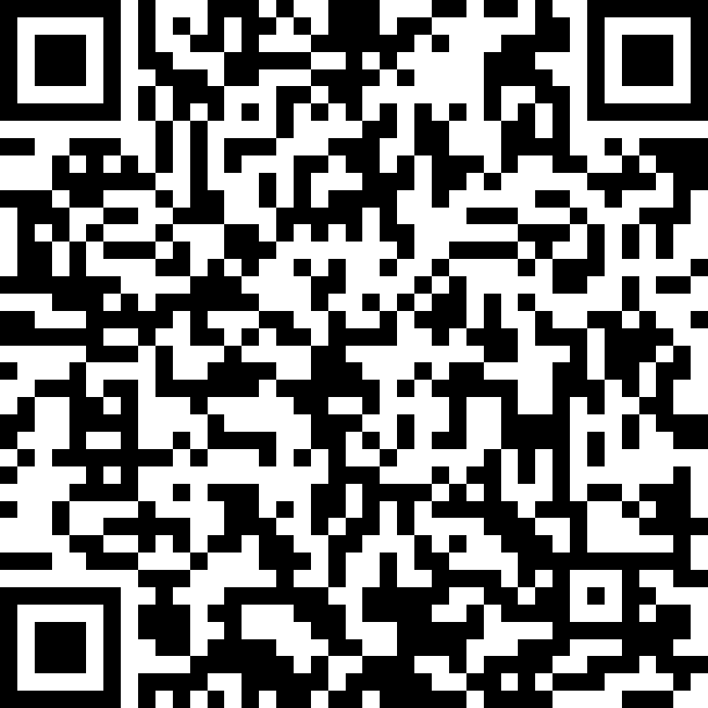
Please fill out the survey! & Win Swags!!
https://bit.ly/GPPBSurvey
Notes:
https://bit.ly/GPPBSurvey

Slide 31
Thank You For Attending

Slide 32
Custom Message
Create custom messages to extend Dataverse
Generate a workflows registered in the stage MainOperation (30) of the execution pipeline.
Plug-ins can be registered on this message
Always execute in organization scope
Runs under the security context of the calling user
WHY ?
Combine multiple message requests into a single request
Message Available through Dataverse Web Services

Slide 33
Server-Side Options
a.k.a: Custom Actions
Plug-ins
Workflow extensions
Cloud Flows
.NET framework assemblies (.dll)
Contain classes that must implement an Interface or base class (Iplugin, CodeActivity)
Deployed to the server and registered using Plug-in Registration tool (PRT)
Require using the .NET Framework SDK Microsoft.CrmSdk.CoreAssemblies
Notes:
CodeActivity

Slide 34

Server-Side Options
Component Types
Plug-ins
Workflows:
Classic Workflows
Custom Actions
Classic Editor
Workflows Extensions (a.k.a: Custom Actions)
Cloud Flows
Component Specifities
.NET framework assemblies (.dll)
Classes that implement an Interface or base class (IPlugin, CodeActivity)
Deployed to the server and registered using Plug-in Registration tool (PRT)
Require using the .NET Framework SDK Microsoft.CrmSdk.CoreAssemblies

Slide 35
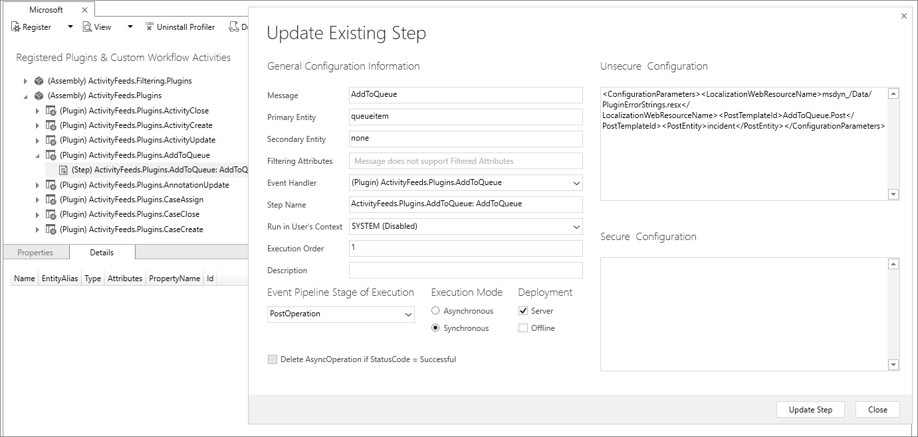
Plug-ins
Notes:
Plug-in data is stored in three entities:
PluginAssembly
Assembly bytes & version + more
PluginType
TypeName + descriptions for Workflow Activities
SdkMessageProcessingStep
Plug-in step registrations only
Stage
Configuration
Mode (synchronous or asynchronous)
Rank (execution order)
Message lookup to SdkMessageFilter entity
+ more

Slide 36
External Interactions with Dataverse
Web API Client
Web API Endpoint
Dataverse platform
New Message: IncrementByTen
SOAP Endpoint
SDK Clients
Notes:
IncrementByTen

Slide 37
External Interactions with Dataverse
Web API Client
Web API Endpoint
Dataverse platform
SDK Clients

